Slide 1

An Enhanced Recommendation System Using Ensemble Learning Techniques (Aersuelt)
Name and Reg. No. Supervisor
Aman Kumar Sharma (22MCB0021) Mr. Parthasarathy G
Harsh Tyagi (22MCB0022) (19042) (SCOPE)
Rajat Moundekar (22MCB0004)
Date: 27/11/2022
Venue: VIT Vellore

Slide 2
CONTENTS
Objective
Introduction
Literature Survey
Proposed Work
Experiments and Results
Summary and Future Scope
References
VIT Vellore

Slide 3
OBJECTIVE
To build an efficient and enhanced recommendation system
using an hybrid model.

Slide 4
INTRODUCTION
Recommendation systems were originally defined as ones in which people provide recommendations as inputs, which the system then aggregates and directs to appropriate recipients. The recommendation system is aimed at providing personalized goods for customers. The recommendation system has been used in many areas. A large amount of research has focused on movie recommendations, music recommendations, news recommendations, hotel recommendations, book recommendations, e-commerce recommendations, tourism recommendations, and many other areas. With the development of the recommendation system, many methods and techniques have been generated. The three major techniques used to build a Recommendation System are content-based, collaborative based, and hybrid-based.

Slide 5
INTRODUCTION
There are mainly 3 types of recommendation system models
Collaborative Recommendation System
Content Based Recommendation System
Hybrid Recommendation system

Slide 6
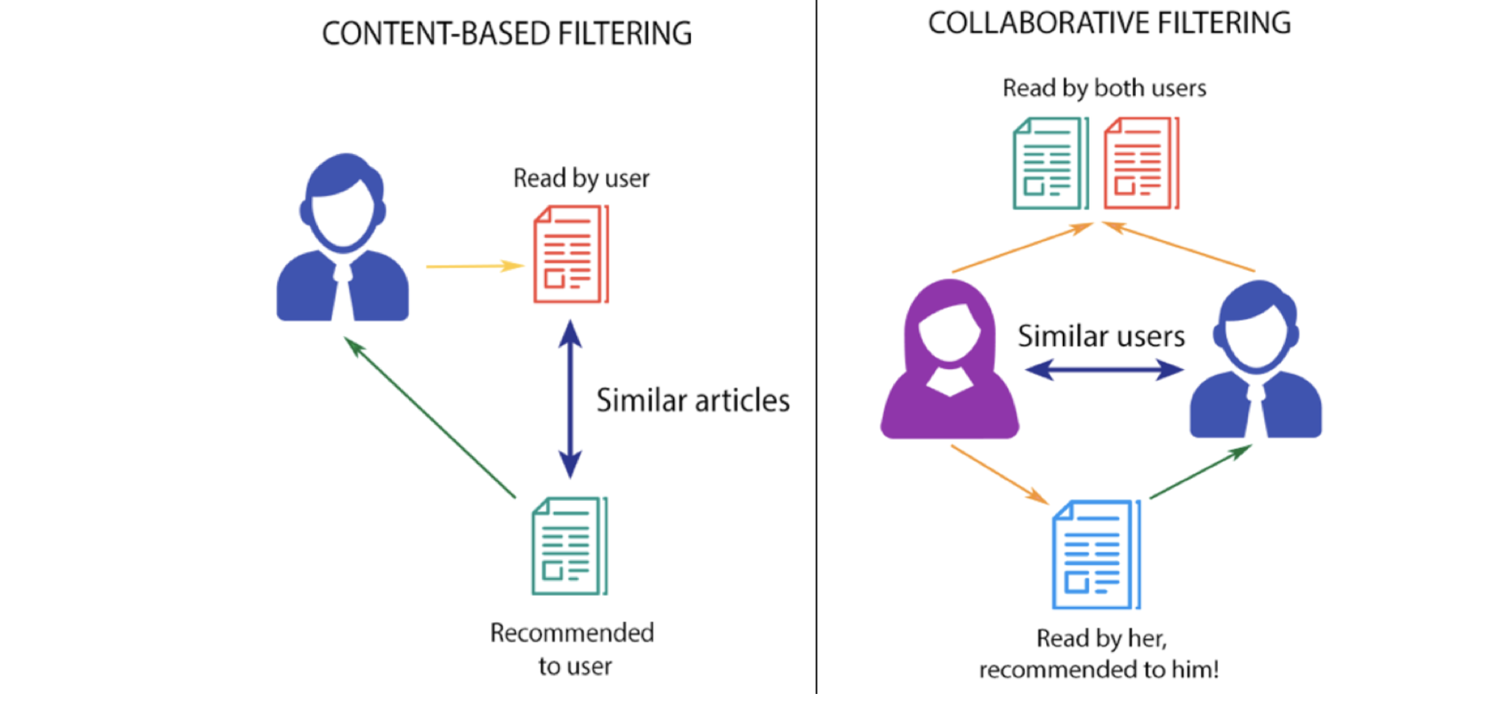
INTRODUCTION
Collaborative Recommendation System

Slide 7
INTRODUCTION
Content Based Recommendation System

Slide 8
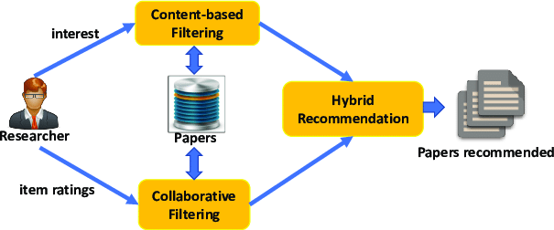
INTRODUCTION
Hybrid Recommendation System

Slide 9
LITERATURE SURVEY
Author & Year | Adopted Scheme | Features | Challenges
Shravanthi K, Sneha Rao S, Swati Joshi, and Vandana R(2019) | CNN and CF | Minimal error | Reduced efficiency
Prachi Singh, Mr. Pankaj K. Singh, Mr. Amit Ganguli, and Mr. Ajit Shrivastava (2020) | Random Forest Algorithm XGB Classifier algorithm | High recall Reduced error | Different accuracies
Xixi Li, Jiahao Xing, Haihui Wang, Lingfang Zheng, Suling Jia1, and Qiang Wang(2017) | weighted similarity | Reduced error | rationality needs to be further improved
M.Sunitha Reddy, T.Adilakshmi, and V. Swathi(2014) | clustering and association mining | Avoid Cold start Improves quality of recommendation | High Execution time

Slide 10
LITERATURE SURVEY
Author & Year | Adopted Scheme | Features | Challenges
Monali Gandhi, Khusali Mistry, and Mukesh Patel(2014) | association mining and collaborative filtering | Avoid Cold start Improves quality of recommendation | High Execution time
Satya Prakash Sahu, Anand Nautiyal, and Mahendra Prasad(2017) | Naïve Bays | Sparsity Handling | Not precise method
Mohammadsadegh Vahidi Farashah, Akbar Etebarian, Reza Azmi(2021) | CBRSs and collaborative filtering as well as clustering techniques and DNN | more accurate than any other methods used before | Execution and processing time of the proposed method are longer
Pasquale Lops, Marco de Gemmis, and Giovanni Semeraro | CBF | Learning оf рrоfile is made easy, Quality improves оver time, Соnsiders implicit feedbасk | does not completely overсоme the рrоblem of over-sрeсiаlizаtiоn and serendipity.

Slide 11
PROBLEM STATEMENT
Based on the Literature survey, the following issues are
still existing in RS.
1. Scalability
2. Cold Start
3. Sparsity
To solve the above issues, a hybrid recommendation model is Proposed.

Slide 12
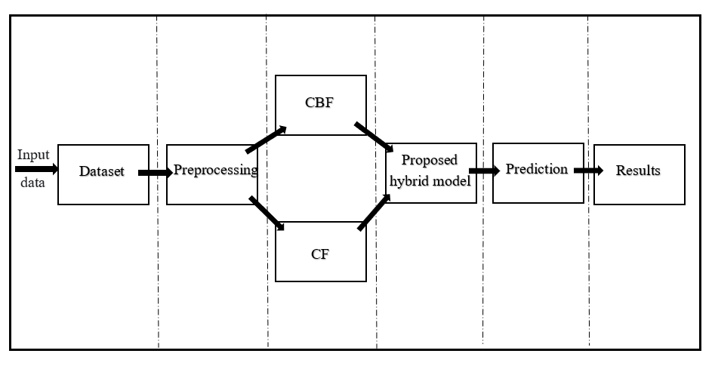
Proposed System

Slide 13
Dataset
Dataset | Users(Unique) | Songs(Unique) | Total data
Million Songs | 70836 | 3420 | 651738

Slide 14
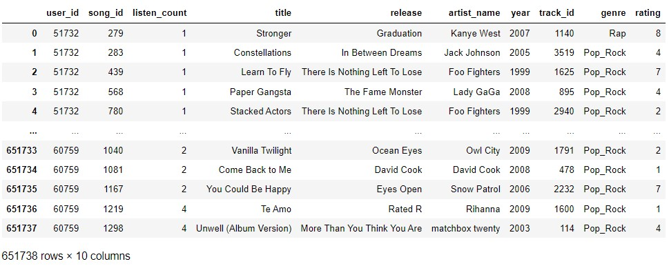
Dataset

Slide 15
Proposed Preprocessing Techniques-I
Sl. No. | Description | Dataset | Description
1. | Data Cleaning | Million song Dataset | Ignore the tuples Remove duplicate or irrelevant observations.
2. | Data Integration | Million song Dataset | Integrated as a single file to process
3. | Label Encoding | Million song Dataset | Converting Labels in numerical form

Slide 16
Experiments and Results

Slide 17
Summary

Slide 18
References

Slide 19
References

Slide 20
Publications

Slide 21
Queries

Slide 22
Thank You

